Slide 1
Correlation
Prepared by
Sajana Shakya

Slide 2
Definition:
The statistical measure which is used to study degree of relationship between two or more variables. It gives degree as well as direction. It is measured by correlation coefficient r. its value lies from -1 to 1.

Slide 3
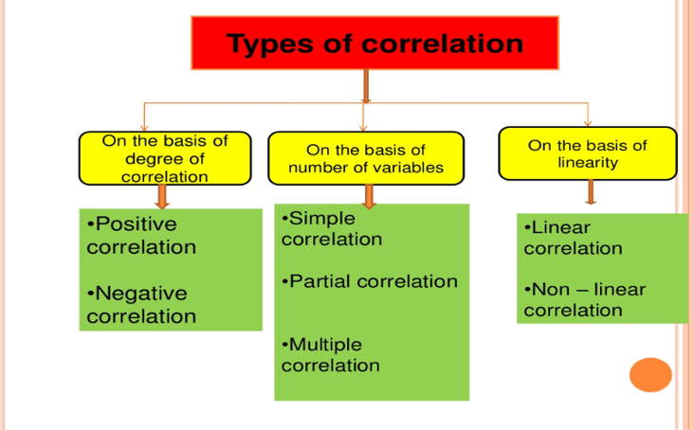

Slide 4
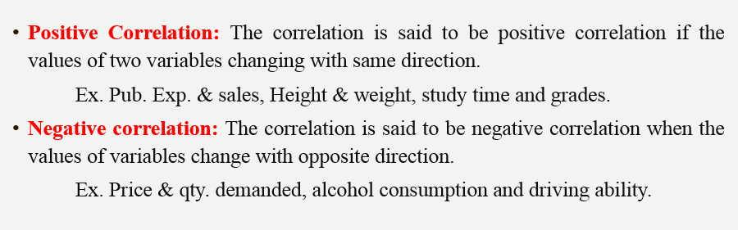

Slide 5

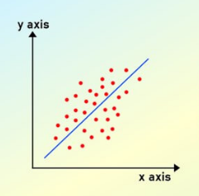

Slide 6
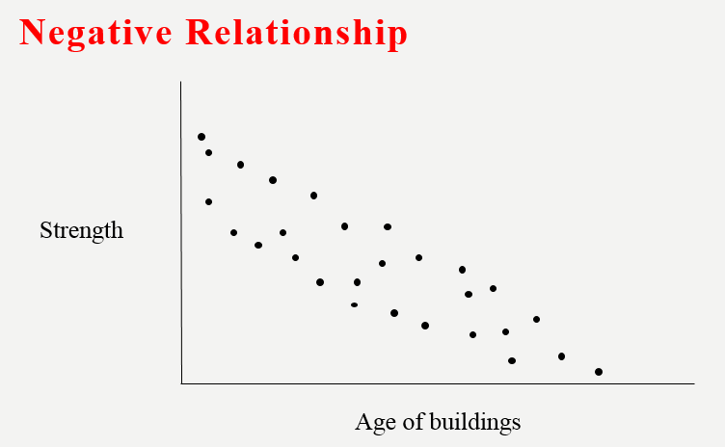

Slide 7
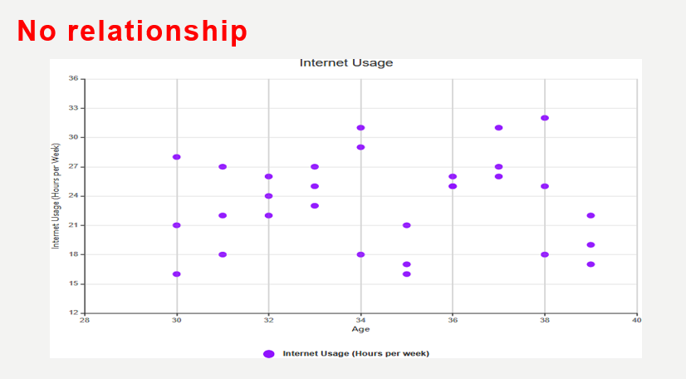

Slide 8
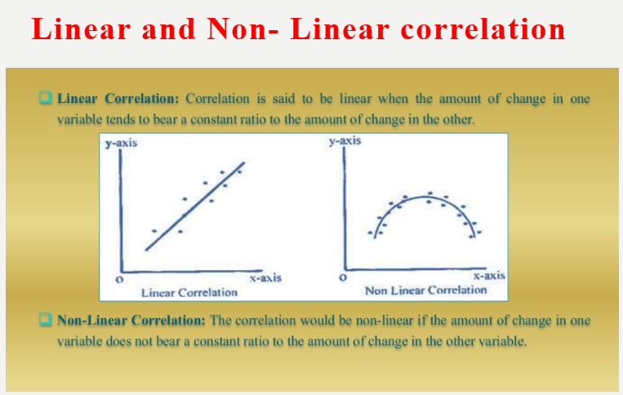

Slide 9
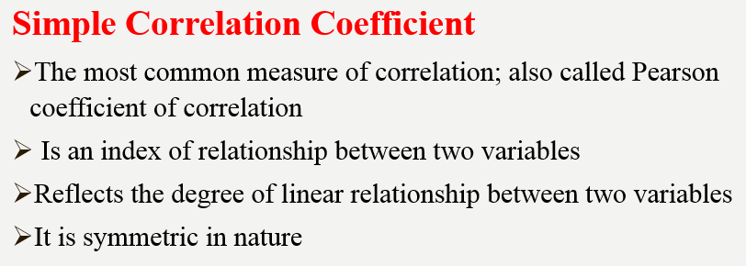

Slide 10
Simple Correlation can be measured by two method
Graphical Method or Scattered plot
Mathematical Method

Slide 11
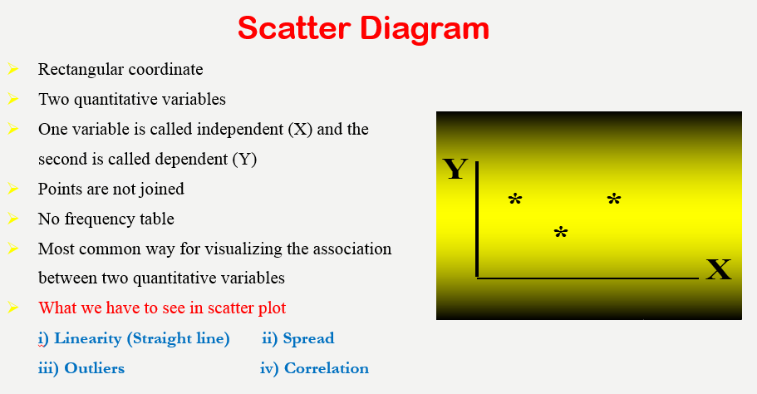

Slide 12
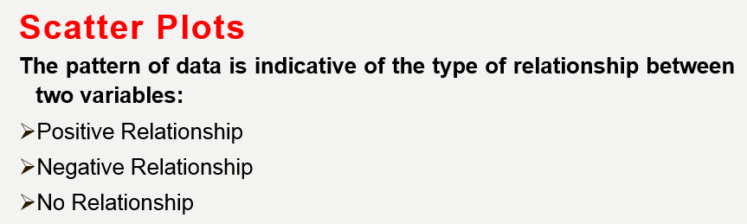

Slide 13
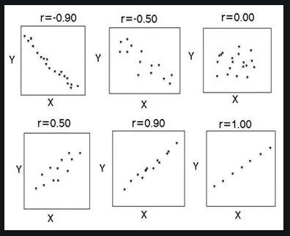

Slide 14
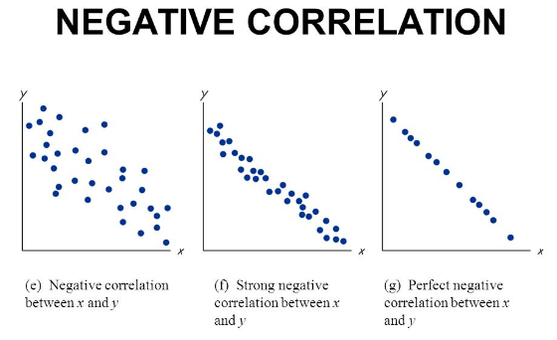

Slide 15
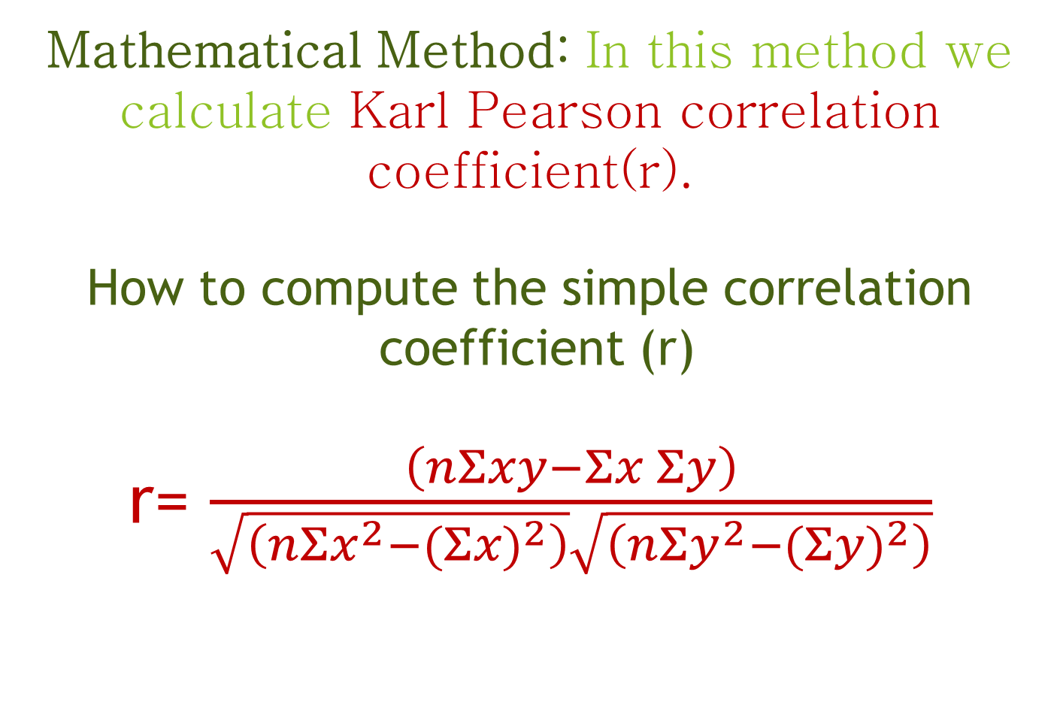
Mathematical Method: In this method we calculate Karl Pearson correlation coefficient(r).
How to compute the simple correlation coefficient (r) r= $\frac{\left(nΣxy−Σx Σy\right)}{\sqrt{\left(nΣx^{2}−{(Σx)}^{2}\right)}\sqrt{\left(nΣy^{2}−{(Σy)}^{2}\right)}}$

Slide 16
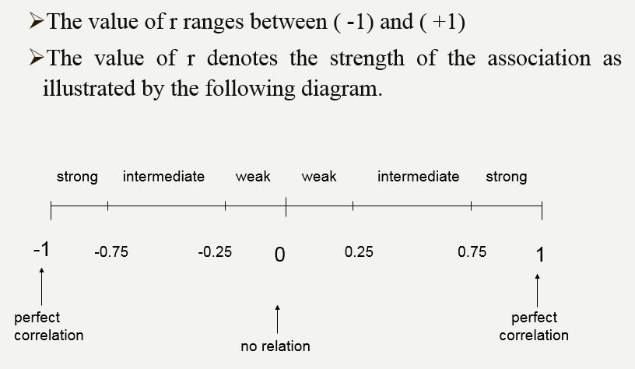

Slide 17
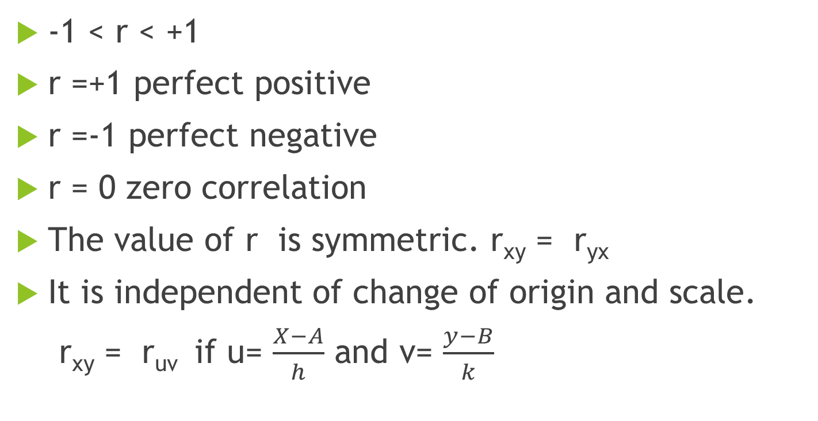
Properties:
-1 < r < +1
r =+1 perfect positive
r =-1 perfect negative
r = 0 zero correlation
The value of r is symmetric. r_{xy} = r_{yx}
It is independent of change of origin and scale.
r_{xy} = r_{uv} if u= $\frac{X−A}{h}$ and v= $\frac{y−B}{k}$

Slide 18
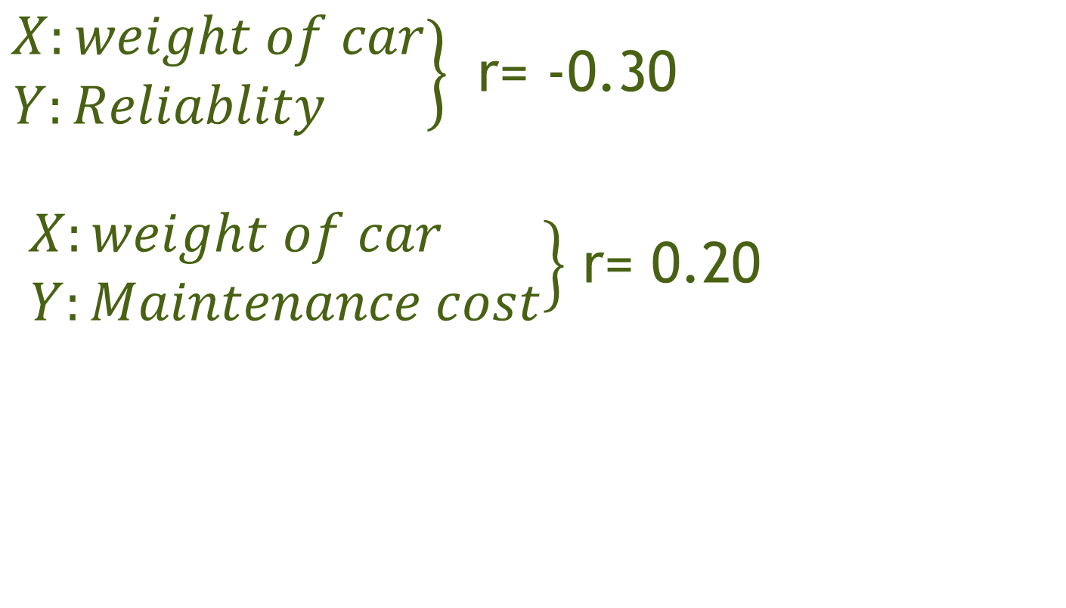
$\left.\begin{aligned}X:weight of car \\ Y:Reliablity \end{aligned}\right\}$ r= -0.30
$\left.\begin{aligned}X:weight of car \\ Y:Maintenance cost\end{aligned}\right\}$ r= 0.20

Slide 19
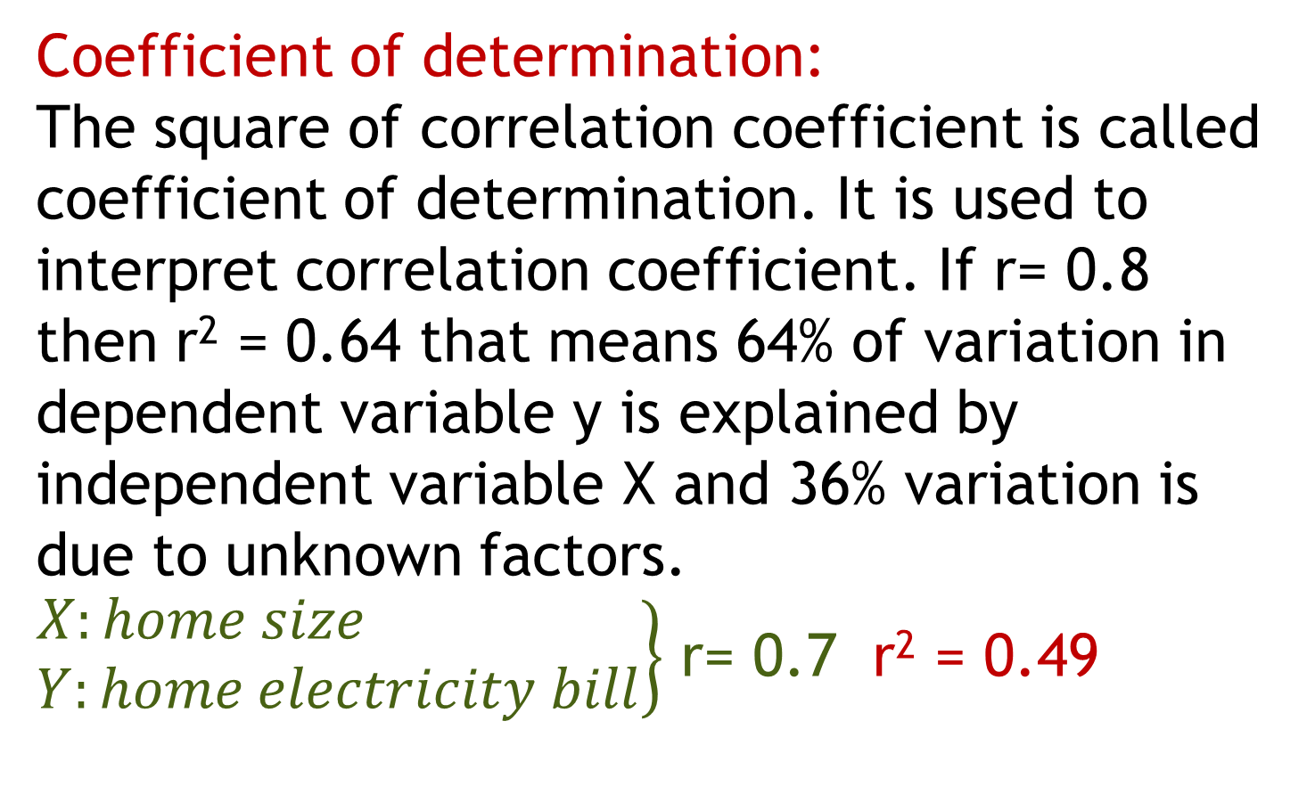
Coefficient of determination:
The square of correlation coefficient is called coefficient of determination. It is used to interpret correlation coefficient. If r= 0.8 then r² = 0.64 that means 64% of variation in dependent variable y is explained by independent variable X and 36% variation is due to unknown factors.
$\left.\begin{aligned}X:home size \\ Y:home electricity bill\end{aligned}\right\}$ r= 0.7 r² = 0.49

Slide 20
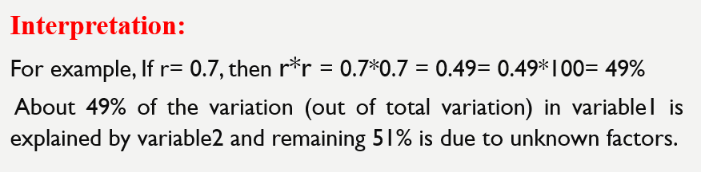

Slide 21
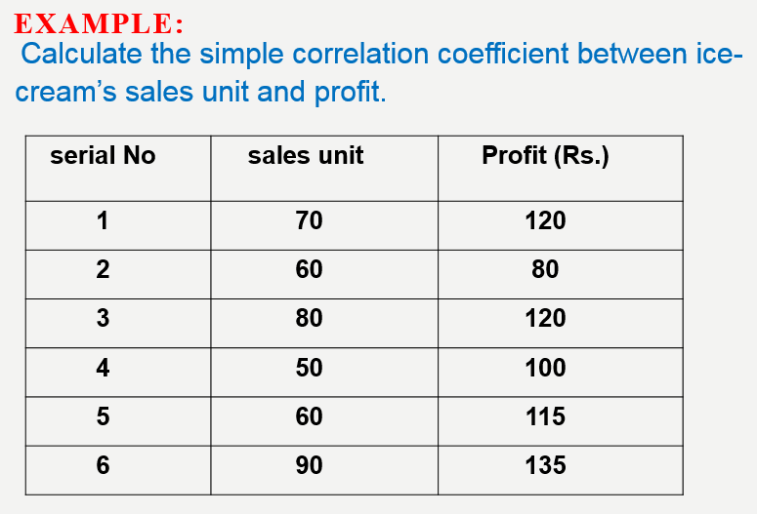

Slide 22
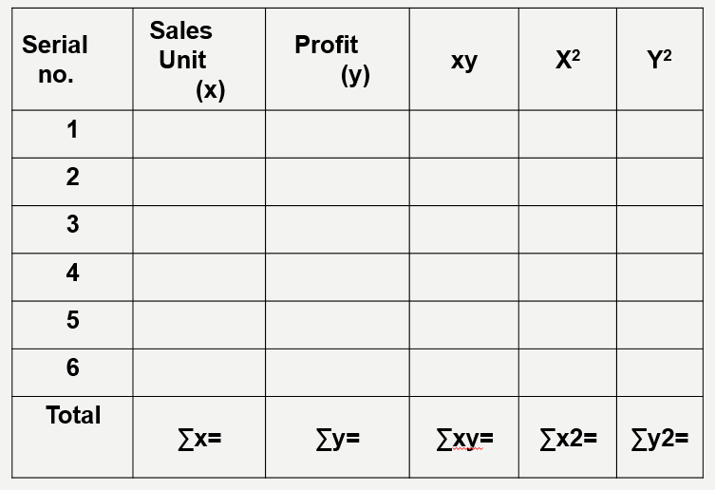

Slide 23
Problem 1:
Calculate the correlation coefficient from following data and draw your conclusion from result:
Sales (Lakhs) | 45 | 56 | 39 | 54 | 45 | 40 | 56 | 60 | 30 | 36
Advertisement cost (000 Rs) | 40 | 36 | 30 | 44 | 36 | 32 | 45 | 42 | 20 | 36

Slide 24
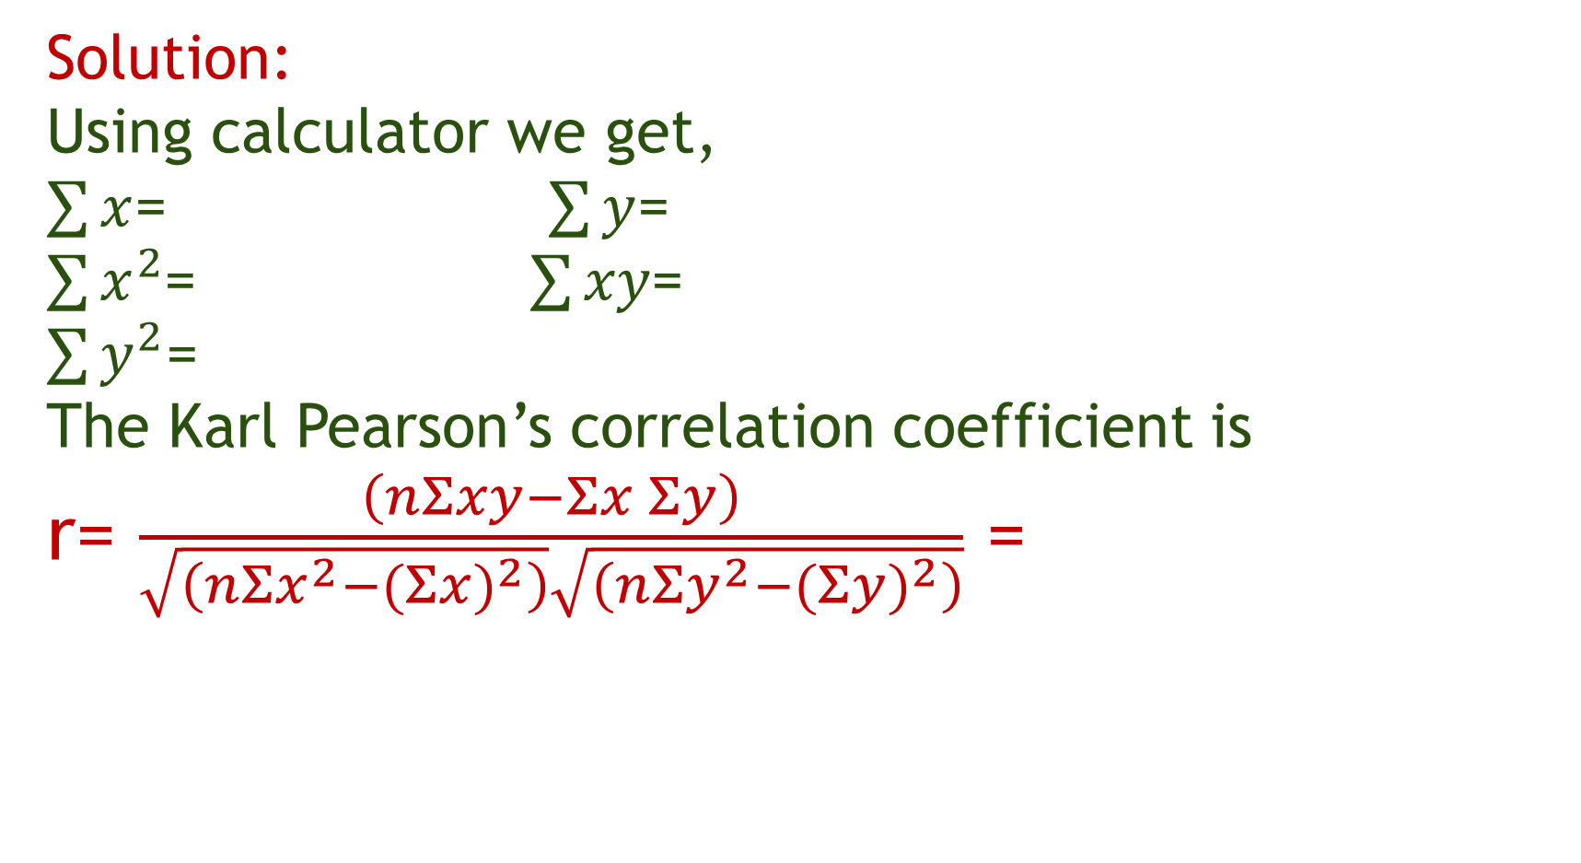
Solution:
Using calculator we get,
$\sum{x}$= $\sum{y}$=
$\sum{x^{2}}$= $\sum{xy}$=
$\sum{y^{2}}$=
The Karl Pearson’s correlation coefficient is r= $\frac{\left(nΣxy−Σx Σy\right)}{\sqrt{\left(nΣx^{2}−{(Σx)}^{2}\right)}\sqrt{\left(nΣy^{2}−{(Σy)}^{2}\right)}}$ =

Slide 25
Problem 2:
Ten steel wires of diameter 0.5 mm and length 2.5m were extended in a laboratory by applying vertical forces of varying magnitudes. Results are as follows:
Determine the correlation coefficient and coefficient of determination between the force and increase in length and interpret the result using coefficient of determination.
Force (kg) x | 15 | 19 | 25 | 35 | 42 | 48 | 53 | 56 | 62 | 65
Increase in length (mm) y | 1.7 | 2.1 | 2.5 | 3.4 | 3.9 | 4.9 | 5.4 | 5.7 | 6.6 | 7.2

Slide 26
Partial Correlation
The study of degree of relationship between one dependent variable and one independent variable by keeping all other independent variables constant is called Partial Correlation.
For eg: X₁=advertisement cost
X₂=sales of mobile phones
X₃ =price

Slide 27
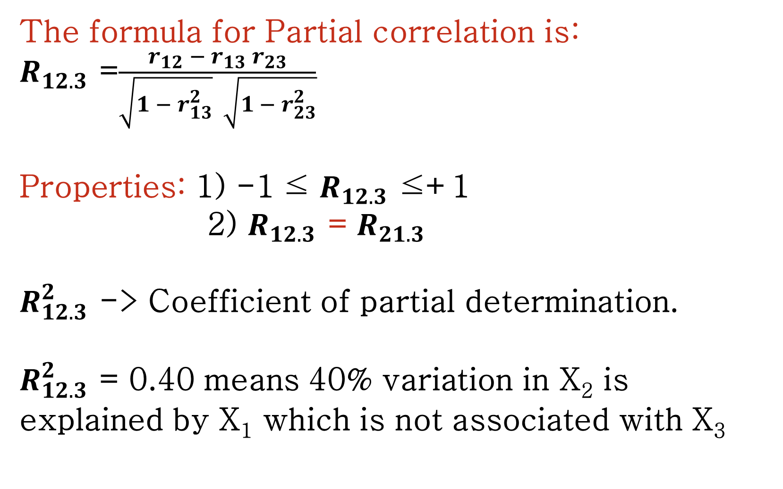
The formula for Partial correlation is:
$R_{12.3}$ =$\frac{r_{12} − r_{13} r_{23}}{\sqrt{1 −{ r}_{13}^{2}} \sqrt{1 −{ r}_{23}^{2}}}$
Properties: 1) -1 ≤ $R_{12.3}$ ≤+1
2) $R_{12.3}$ = $R_{21.3}$
$R_{12.3}^{2}$ -> Coefficient of partial determination.
$R_{12.3}^{2}$ = 0.40 means 40% variation in X₂ is explained by X₁ which is not associated with X₃

Slide 28
Multiple Correlation
The study of degree of relationship between one dependent variable and joint effect of all other independent variables is called Multiple Correlation.
For eg: X₁= sales of mobile phones
X₂= advertisement cost
X₃ =price

Slide 29
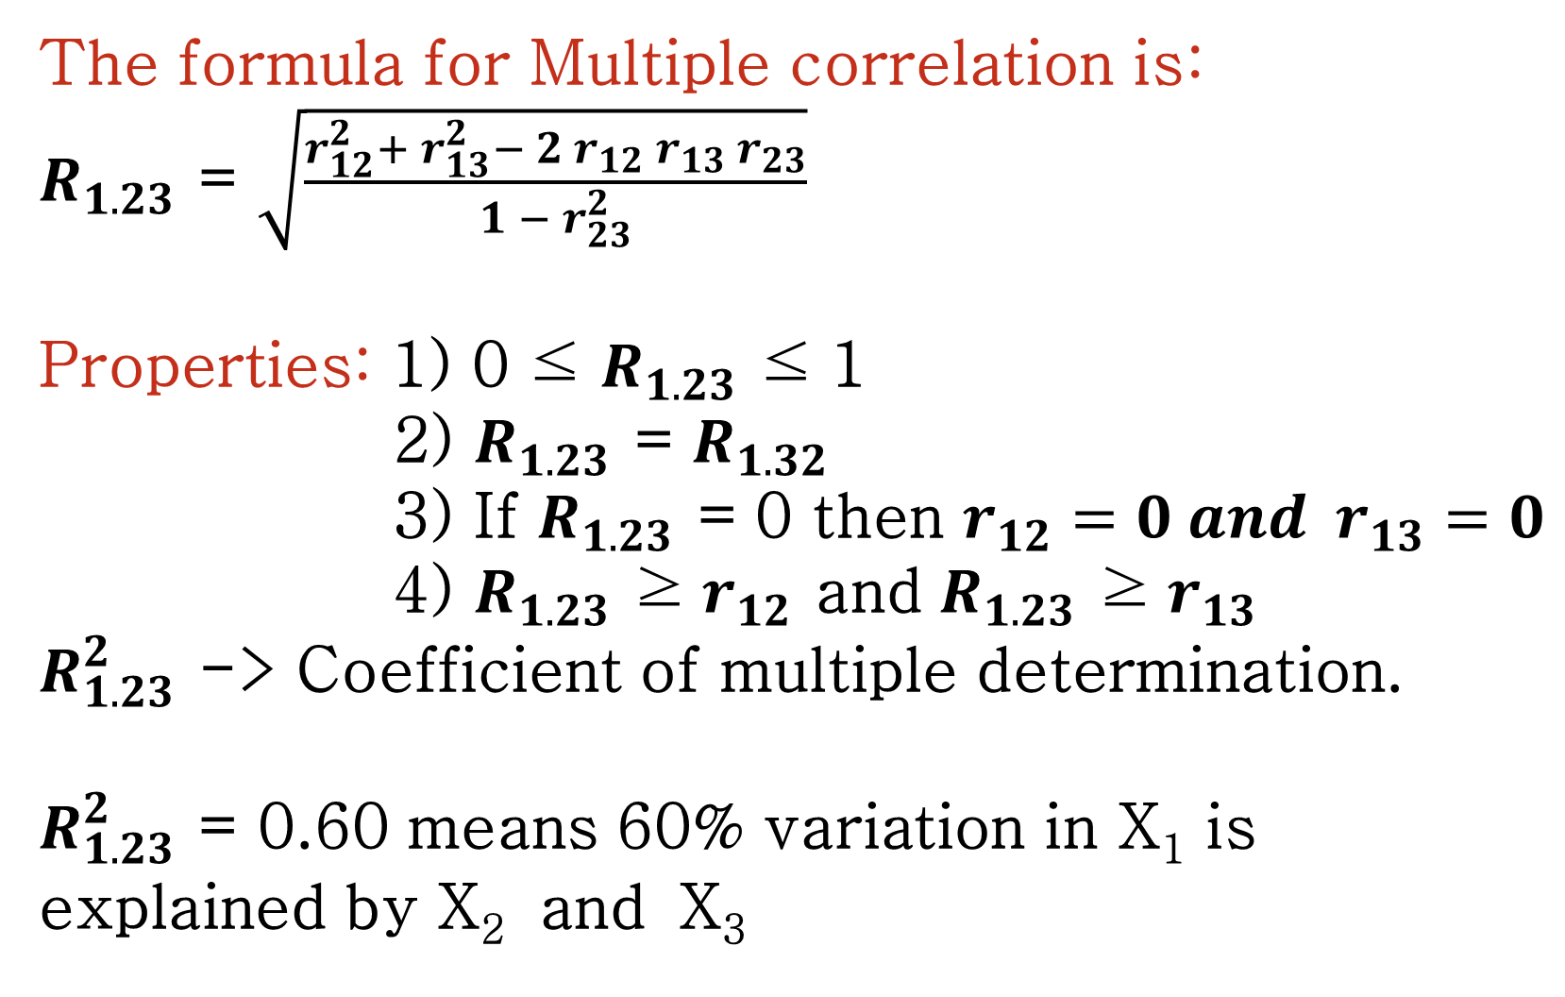
The formula for Multiple correlation is:
$R_{1.23}$ = $\sqrt{\frac{r_{12}^{2}+ r_{13}^{2}− 2 r_{12} r_{13} r_{23}}{1 − r_{23}^{2}}}$
Properties: 1) 0 ≤ $R_{1.23}$ ≤ 1
2) $R_{1.23}$ = $R_{1.32}$
3) If $R_{1.23}$ = 0 then $r_{12}=0 and r_{13}=0$
4) $R_{1.23}$ ≥ $r_{12}$ and $R_{1.23}$ ≥ $r_{13}$
$R_{1.23}^{2}$ -> Coefficient of multiple determination.
$R_{1.23}^{2}$ = 0.60 means 60% variation in X₁ is explained by X₂ and X₃

Slide 30
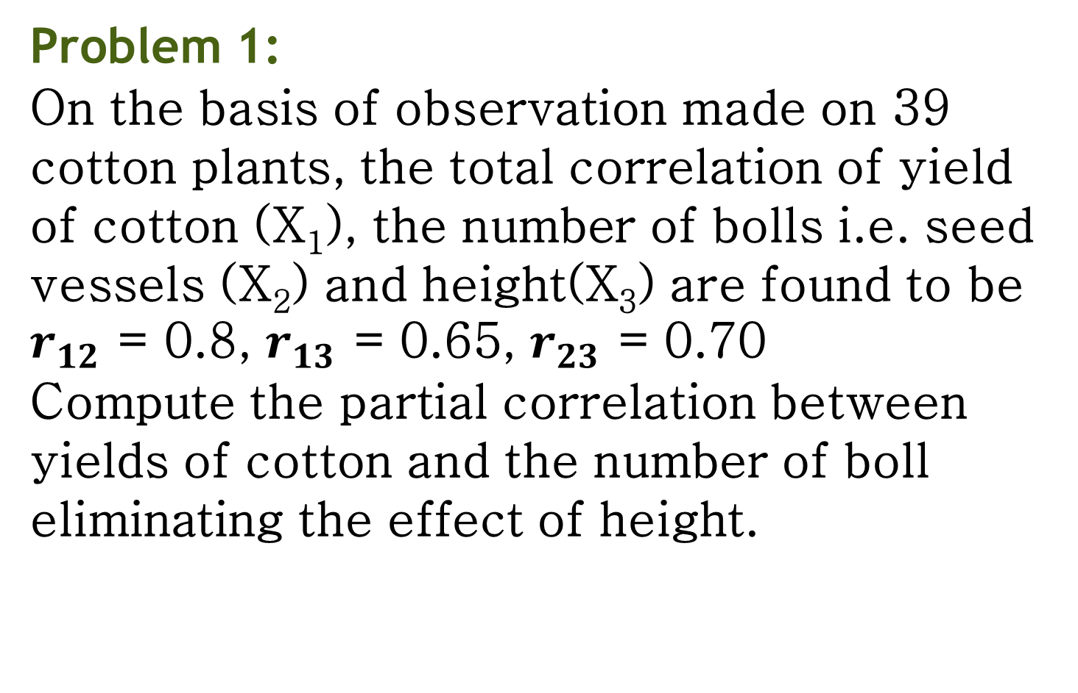
Problem 1:
On the basis of observation made on 39 cotton plants, the total correlation of yield of cotton (X₁), the number of bolls i.e. seed vessels (X₂) and height(X₃) are found to be $r_{12}$ = 0.8, $r_{13}$ = 0.65, $r_{23}$ = 0.70
Compute the partial correlation between yields of cotton and the number of boll eliminating the effect of height.

Slide 31
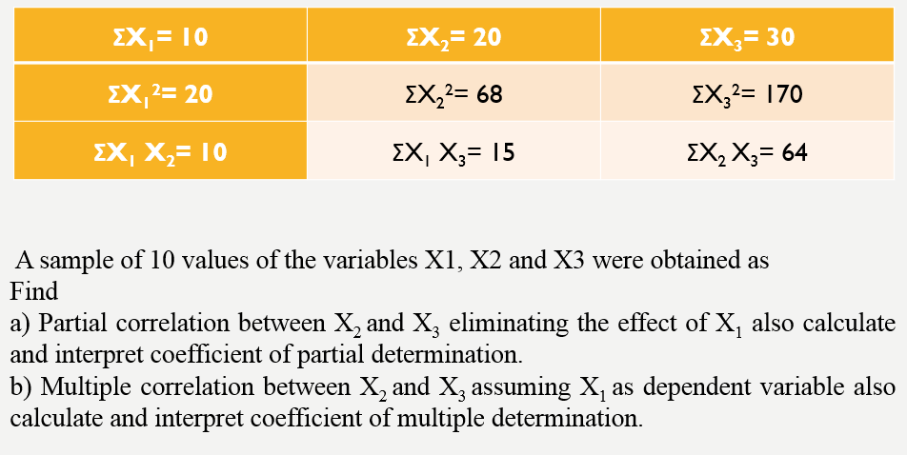
Problem 2:

Slide 32
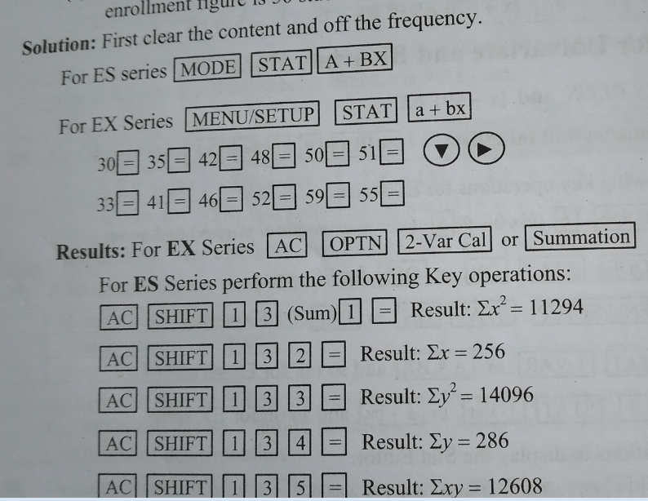

Slide 33
